Slide 1
RPC

Slide 2
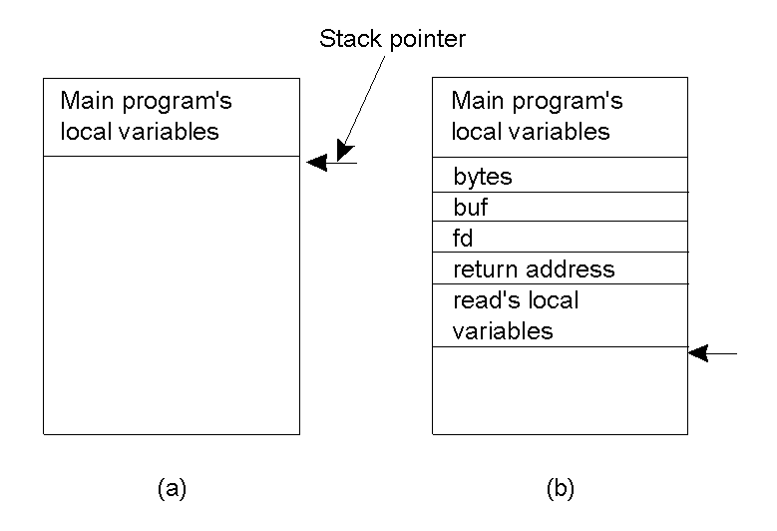
Conventional Procedure Call
Parameter passing in a local procedure call: the stack before the call to read
b) The stack while the called procedure is active

Slide 3
Parameter Passing
Local procedure parameter passing
  Call-by-value
  Call-by-reference: arrays, complex data structures
Remote procedure calls simulate this through:
  Stubs – proxies
  Flattening – marshalling

Slide 4
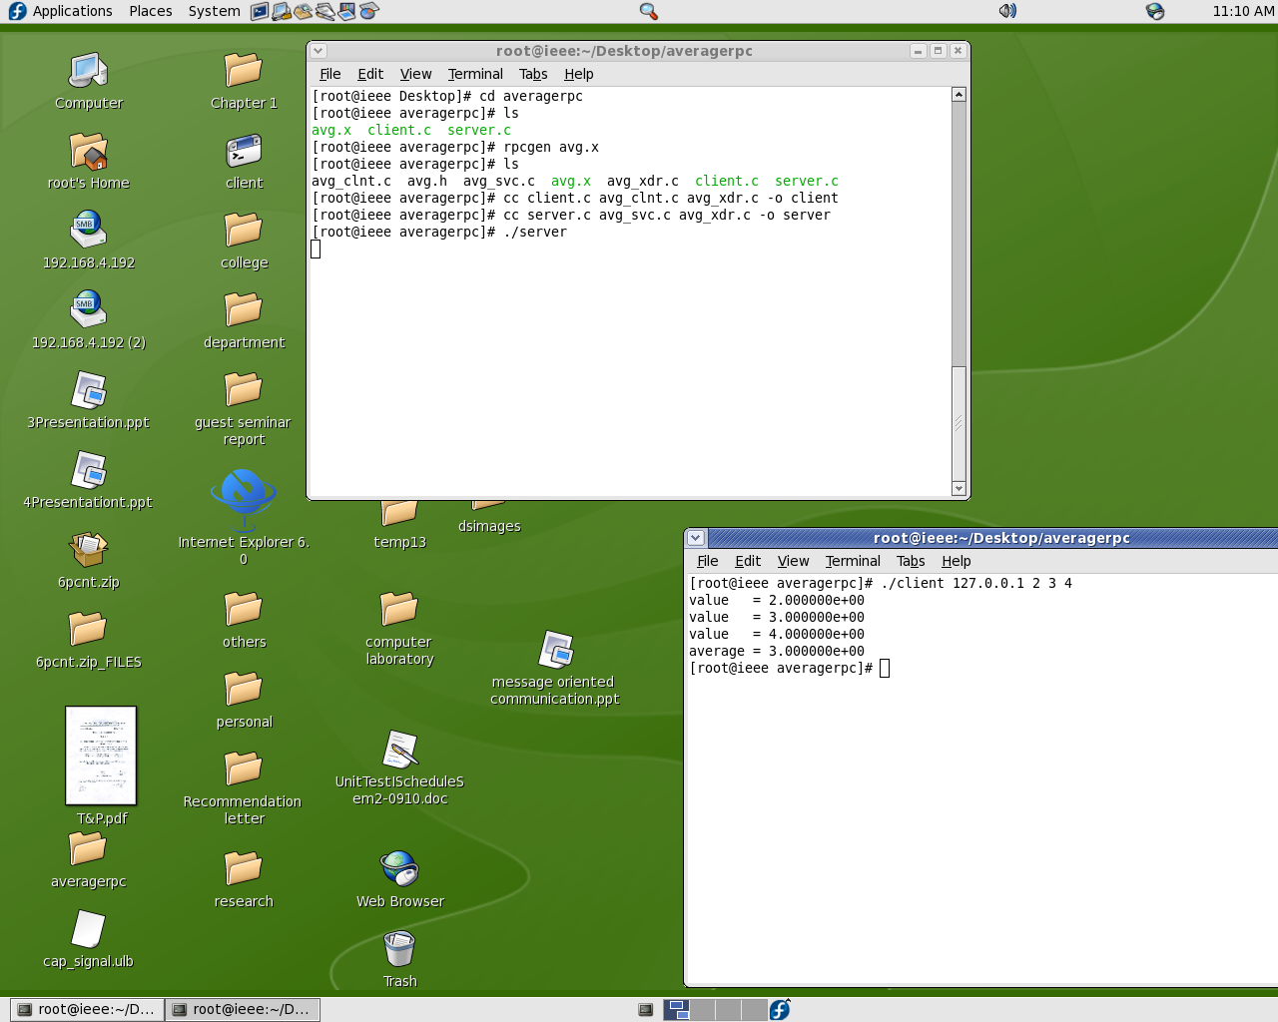
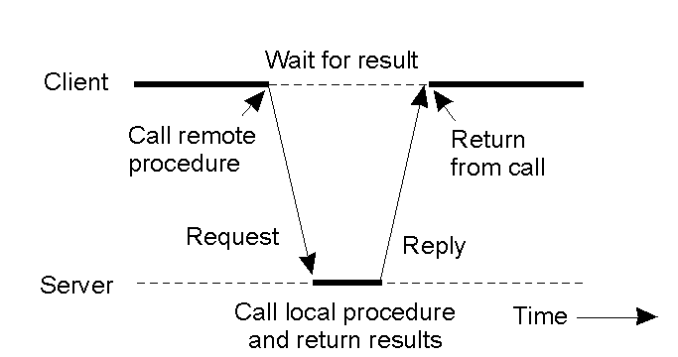
Client and Server Stubs
Principle of RPC between a client and server program.

Slide 5
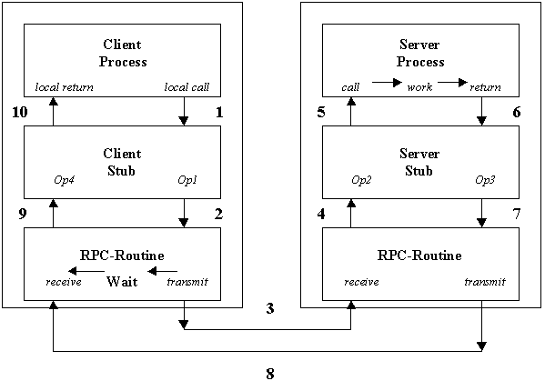
Steps of a Remote Procedure Call

Slide 6
Steps of a Remote Procedure Call
Client procedure calls client stub in normal way
Client stub builds message, calls local OS
Client's OS sends message to remote OS
Remote OS gives message to server stub
Server stub unpacks parameters, calls server
Server does work, returns result to the stub
Server stub packs it in message, calls local OS
Server's OS sends message to client's OS
Client's OS gives message to client stub
Stub unpacks result, returns to client

Slide 7
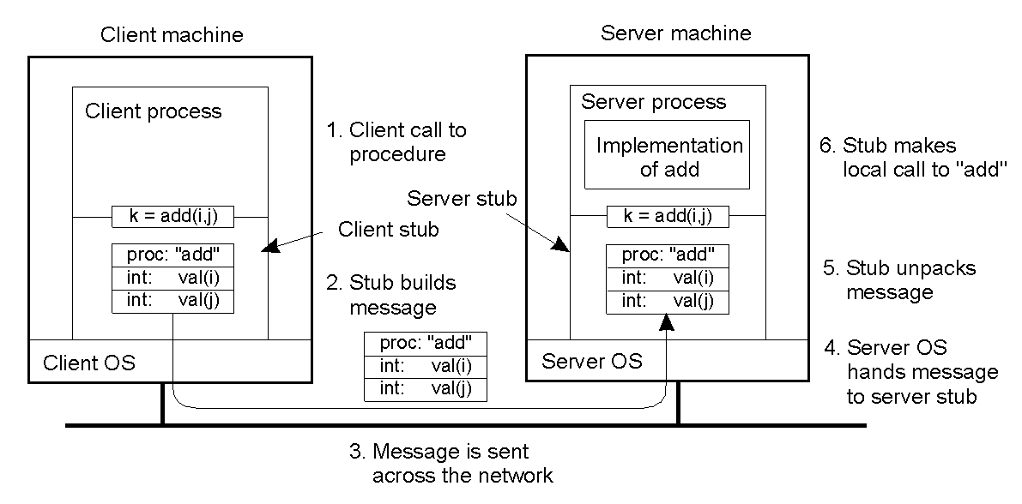
Example of an RPC
2-8

Slide 8
Points regarding RPC
Hiding a remote procedure call requires that caller and callee agree on the format of message they exchange.
Client and server to agree on representation of simple data structures such as integers, characters, Booleans etc.
Caller and callee agree on the protocol.

Slide 9
avg.x file content
const MAXAVGSIZE = 200;
struct input_data {
double input_data<200>;
};
typedef struct input_data input_data;
program AVERAGEPROG {
version AVERAGEVERS {
double AVERAGE(input_data) = 1;
} = 1;
} = 22855;

Slide 10
RPC Message format
Call message
Message identifier
Message type
Client identifier
Remote Procedure Identifier : Program No, Version No, Procedure No
Arguments

Slide 11
RPC Message format
Reply message
Message identifier
Message type
Reply status
Result

Slide 12
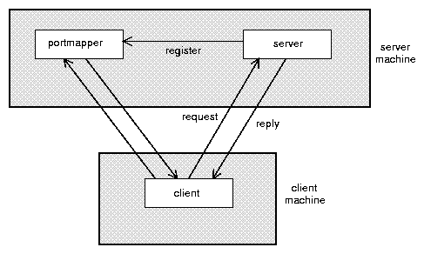
Binder: Port Mapper
Server start-up: create port
Server stub calls svc_register to register prog. #, version # with local port mapper
Port mapper stores prog #, version #, and port
Client start-up: call clnt_create to locate server port
Upon return, client can call procedures at the server

Slide 13
Lightweight RPCs
Many RPCs occur between client and server on same machine
  Need to optimize RPCs for this special case => use a lightweight RPC mechanism (LRPC)‏
Server S exports interface to remote procedures
Client C on same machine imports interface
OS kernel creates data structures including an argument stack shared between S and C

Slide 14
Lightweight RPCs
RPC execution
  Push arguments onto stack
  Trap to kernel
  Kernel changes mem map of client to server address space
  Client thread executes procedure (OS upcall)‏
  Thread traps to kernel upon completion
  Kernel changes the address space back and returns control to client
Called “doors” in Solaris

Slide 15
Other RPC Models
Asynchronous RPC
  Request-reply behavior often not needed
  Server can reply as soon as request is received and execute procedure later
Deferred-synchronous RPC
  Use two asynchronous RPCs
  Client needs a reply but can’t wait for it; server sends reply via another asynchronous RPC
One-way RPC
  Client does not even wait for an ACK from the server
  Limitation: reliability not guaranteed (Client does not know if procedure was executed by the server).

Slide 16
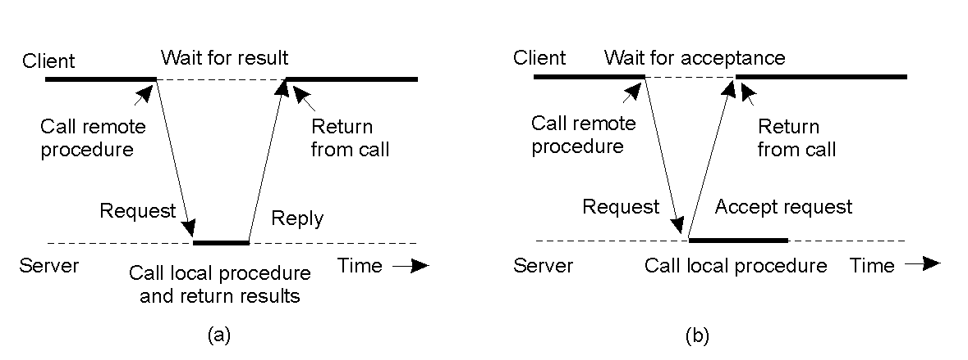
Asynchronous RPC
2-12
The interconnection between client and server in a traditional RPC
The interaction using asynchronous RPC

Slide 17
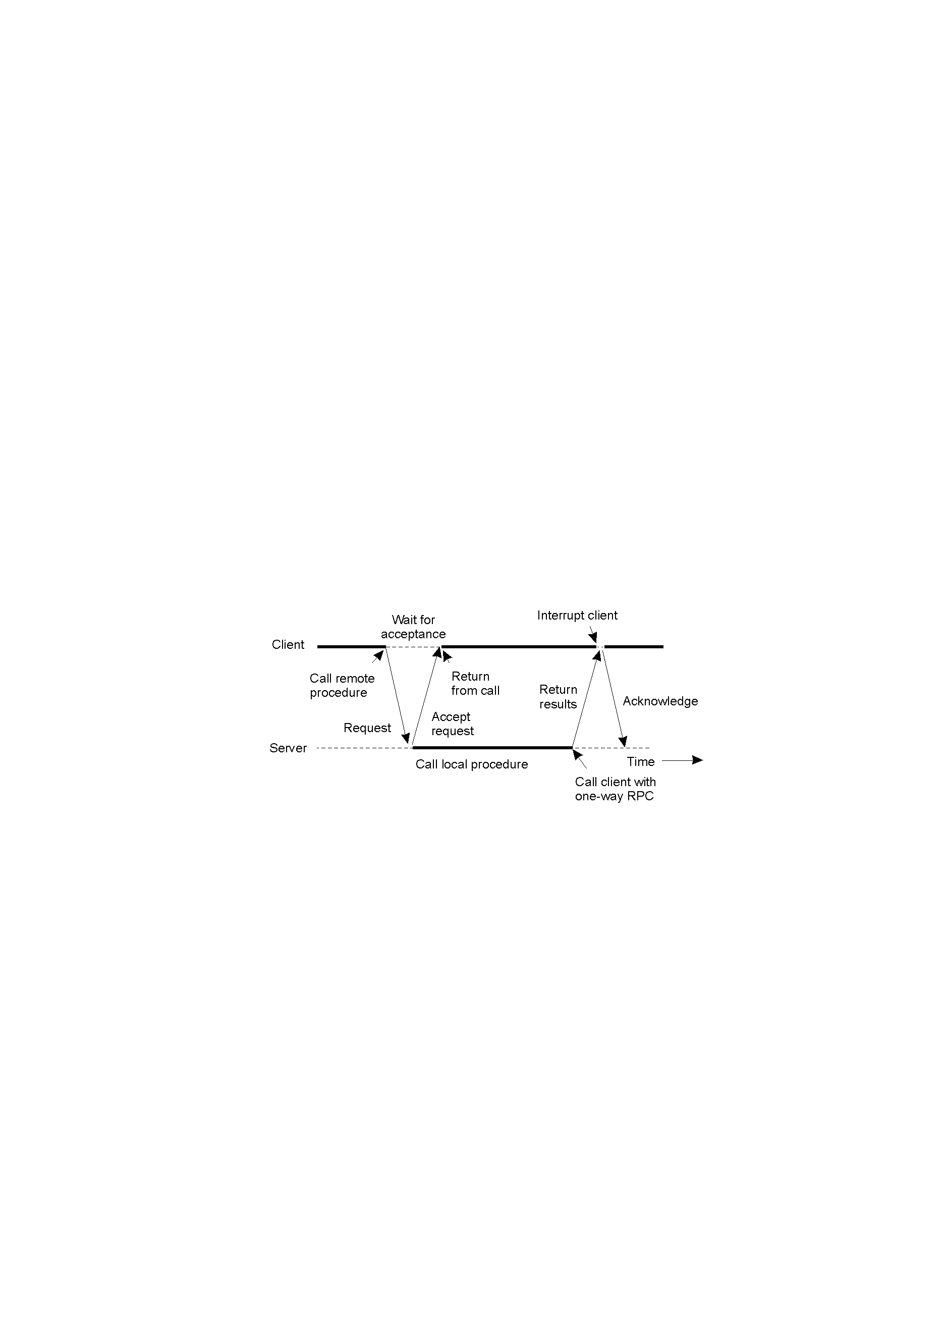
Deferred Synchronous RPC
A client and server interacting through two asynchronous RPCs
2-13

